Slide 1
Technical Arts (TA 101AA) Engineering Graphics
Prof. Nachiketa Tiwari
Department of Design

Slide 2
Lecture Schedule
No. | Date | No. | Date
1 | 24-03-2022 | Mid-Sem | 12-05-2022
2 | 29-03-2022 | MS BRK | 17-05-2022
3 | 31-03-2022 | MS BRK | 19-05-2022
4 | 05-04-2022 | 13 | 24-05-2022
5 | 07-04-2022 | 14 | 26-05-2022
6 | 12-04-2022 | 15 | 31-05-2022
Mah. Jay. | 14-04-2022 | 16 | 02-06-2022
7 | 19-04-2022 | 17 | 07-06-2022
8 | 21-04-2022 | 18 | 09-06-2022
9 (SAT) | 23-04-2022 | 19 | 14-06-2022
10 | 26-04-2022 | 20 | 16-06-2022
11 | 28-04-2022 | 21 | 21-06-2022
Id Fitr | 03-05-2022 | 22 | 23-06-2022
12 | 05-05-2022 | 23 | 28-06-2022
Mid-Sem | 10-05-2022 | 24 | 30-06-2022
TUESDAYS
3 to 4 PM
THURSDAYS
2 to 3 PM

Slide 3
Laboratory & Homework Schedule
LABORATORY |  |  |  | HOME WORK SCHEDULE
No. | Date | Time |  | No. | Date | Time Due
1 | 30-03-2022 | 10 AM to 1 PM |  | 1 | 30-03-2022 | 9:00 AM
2 | 06-04-2022 | 10 AM to 1 PM |  | 2 | 06-04-2022 | 9:00 AM
3 | 13-04-2022 | 10 AM to 1 PM |  | 3 | 13-04-2022 | 9:00 AM
4 | 20-04-2022 | 10 AM to 1 PM |  | 4 | 20-04-2022 | 9:00 AM
5 | 27-04-2022 | 10 AM to 1 PM |  | 5 | 27-04-2022 | 9:00 AM
6 | 04-05-2022 | 10 AM to 1 PM |  | 6 | 04-05-2022 | 9:00 AM
7 | TBD |  |  | 7 | TBD
8 | TBD |  |  | 8 | TBD
9 | TBD |  |  | 9 | TBD
10 | TBD |  |  | 10 | TBD
11 | TBD |  |  | 11 | TBD
TBD: To be decided |  |  |  | TBD: To be decided

Slide 4
Lectures before the mid-semester examination
Live lectures at designated times and dates.
After each lecture, recording of the lecture will be uploaded on MOOKIT platform.
Before the mid-semester examination, all Laboratory Assignments to be submitted BEFORE 1.20 PM on designated dates via the MOOKIT platform.
Before the mid-semester examination, all Homework Assignments to be submitted BEFORE 9 AM on designated dates via the MOOKIT platform.
Details on lectures, homework, and labs after mid-semester examination to be worked out later.

Slide 5
Administrivia contd.
BEFORE THE MID-SEMESTER EXAMS
All sheets used for an assignment should be scanned or photographed and merged into a single PDF file. It should be named using the following format. XXXXXXX: Roll no.
L3-Harsh-XXXXXXX.pdf for LAB 3
H2-Harsh-XXXXXXX.pdf for Home Work 2

Slide 6
About Your Section
The entire class size is about 600 strong. It has been broken into 16 sections.
Identify your section by visiting the MOOKIT platform.
You will attend the labs WITHIN your SECTION.
Each SECTION is also assigned a TUTOR.

Slide 7
Who is Your Tutor?
NAME | EMAIL | SECTION
PROF. ASHISH DUTTA | adutta@iitk.ac.in | C1
PROF. BISHAKH BHATTACHARYA | bishakh@iitk.ac.in | C2
DEEPAK KUMAR MAURYA (18201265) | dkmaurya@iitk.ac.in | C3
INDRANEEL SENGUPTA ( 18203262) | neelisg@iitk.ac.in | C4
PROF. K V HARISH | kvharish@iitk.ac.in | C5
MADHAVRAO VITTHAL LONDHE (16205266) | madhavl@iitk.ac.in | C6
MOHD. SUHAIL NAIM ( 18201267) | msnaim@iitk.ac.in | C7
PROF. NALINAKSH S VYAS | vyas@iitk.ac.in | C8
RETAM PAUL | rpaul@iitk.ac.in | D1
PRASHANT MISHRA (19103278) | mishrap@iitk.ac.in | D2
PRAYAGADHWAJ YADAV | prayagy@iitk.ac.in | D3
RAVI KUMAR (17205266) | ravikm@iitk.ac.in | D4
ROHIT RAJPUT (19103282) | rrajput@iitk.ac.in | D5
SHUBHAM RAJ (18103277) | shubhce@iitk.ac.in | D6
SPANDAN BANDYOPADHYAYA (17101274) | spandan@iitk.ac.in | D7
TEJAS GUPTA (19103288) | tejasgta@iitk.ac.in | D8

Slide 8
Responsibilities of the Tutor
To conduct labs smoothly.
To address your doubts on subject matter related to homework and lab assignments.
To grade your mid-sem and end-sem responses.
However, your lab assignments and homework will be graded by section-specific Teaching Assistants (TAs). The TAs report directly to the respective tutor.

Slide 9
Books
French, T. E., Vierck, C. J., Foster, R. J., Graphics Science and Design. Tata McGraw, 2012.
Bhatt, N. D., Elementary Engineering Drawing, Charoter Publishing, Anand, Thirty First Edition, 1990.

Slide 10
Grading Policy
10% for Homework
25% for Labs
30% for Mid-semester examination
35% for End-semester examination
No makeup labs for ONLINE portion (unless there is very special exemption by your tutor)
No makeup labs for OFFLINE portion (unless there is a very special exemption by DOAA)

Slide 11
What is Required?
Two good quality drawing / Sketch books of size A4 (290 mm x 210 mm).
For laboratory work
For home work.
A blank sketch book/note book for free hand sketching.
A drafter (to be used when we go OFFLINE)

Slide 12
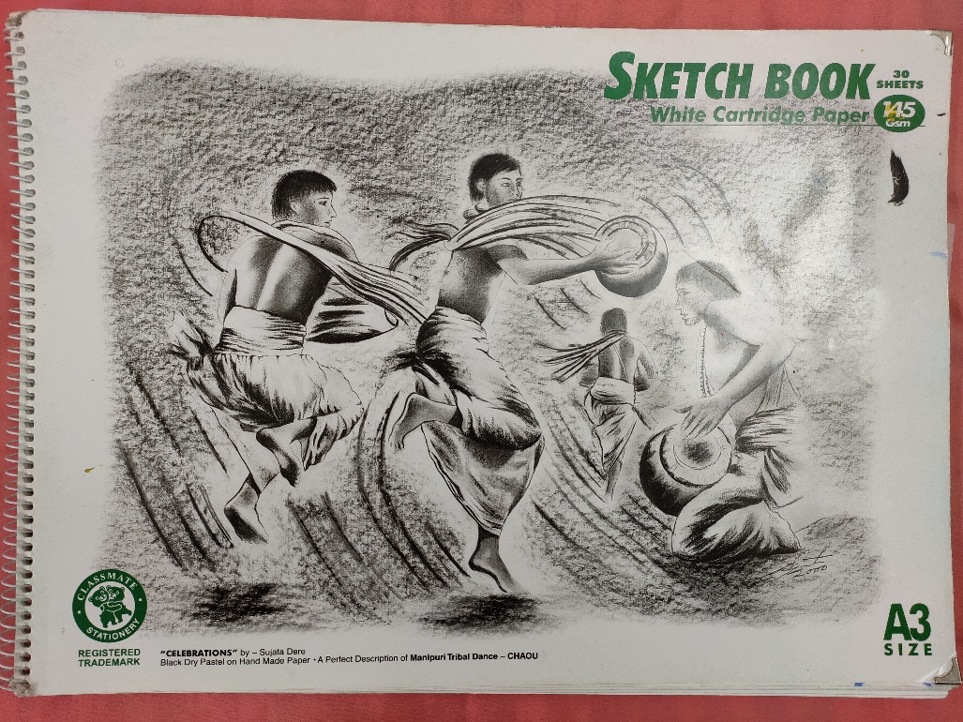
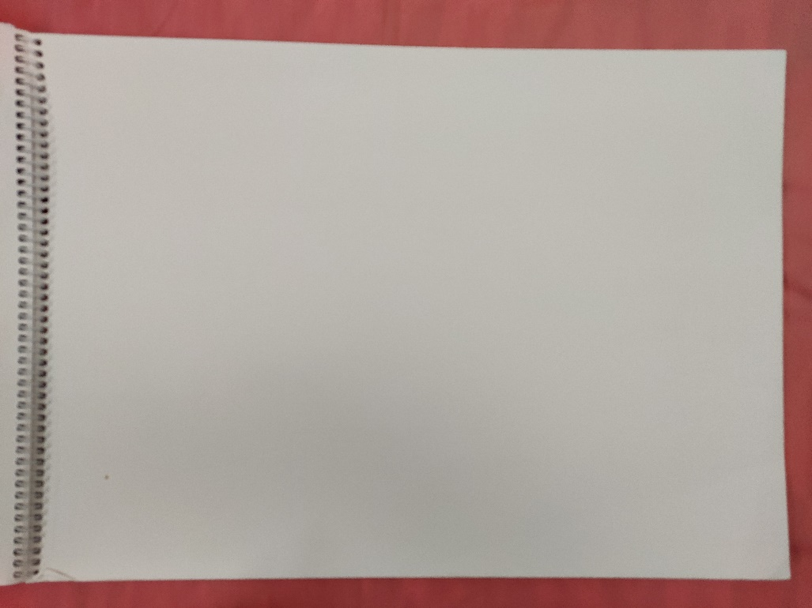

Drawing Book (size 295 x 210 mm)

Slide 13
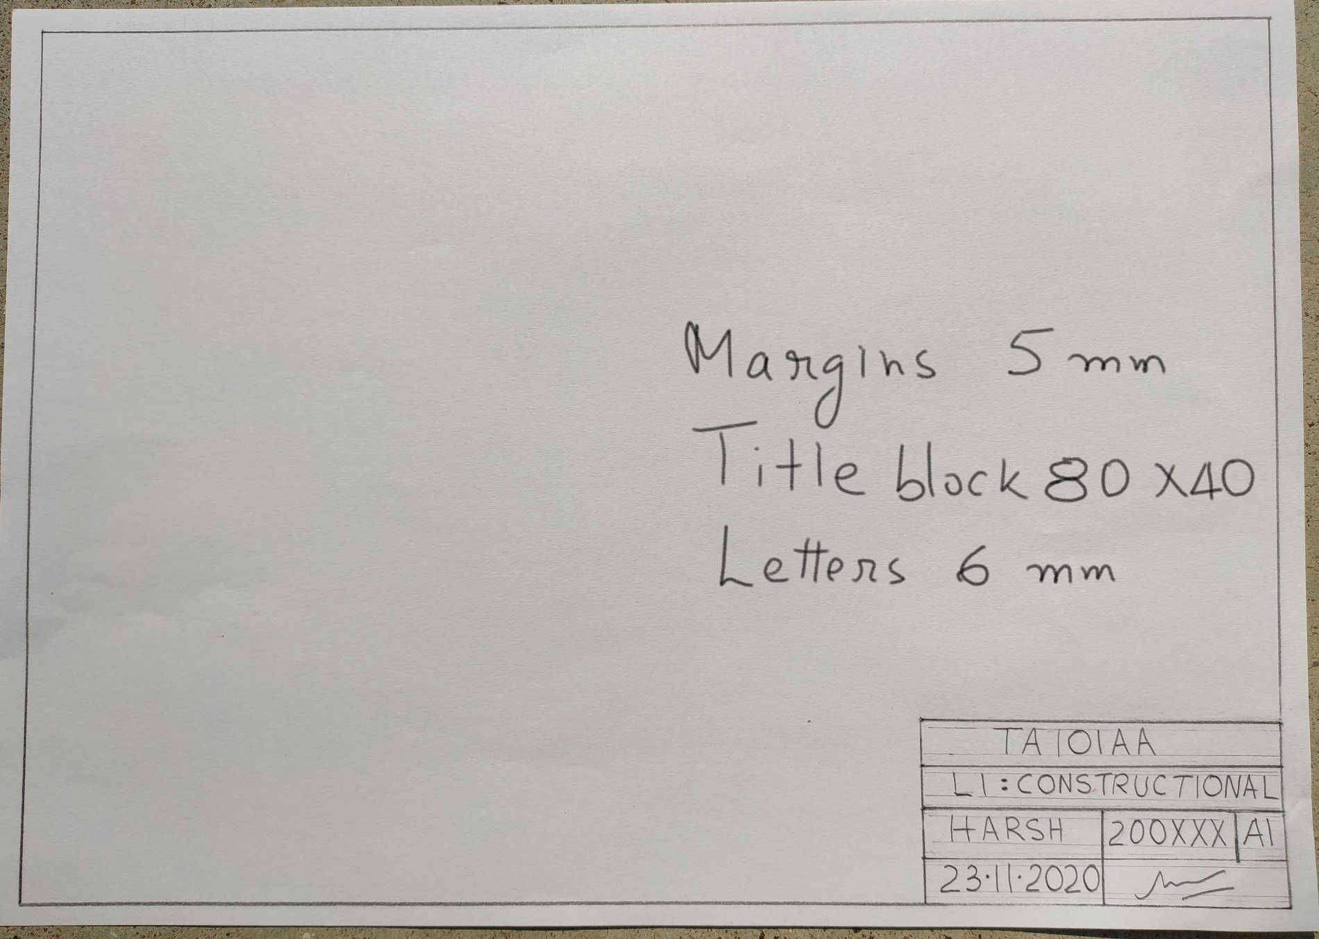
Drawing Sheet

Slide 14
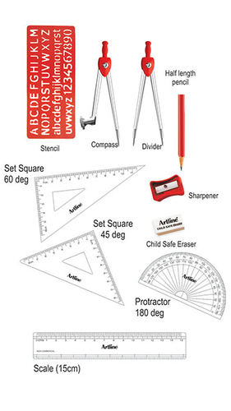
Other Stuff
One geometry box
Compass
Divider
A pair of set – squares : 45º – 45º and 30⁰ – 60º
Protractor
Scale 150 mm (hard plastic or steel)
Drawing pencils (Grade 2H, H, HB) ,
Lead for compass.
A sharpener and eraser
Ruler (300 mm)
A clean soft cloth
One black back up sheet if you are unable to get drawing book and are using A4 size sheet.

Slide 15
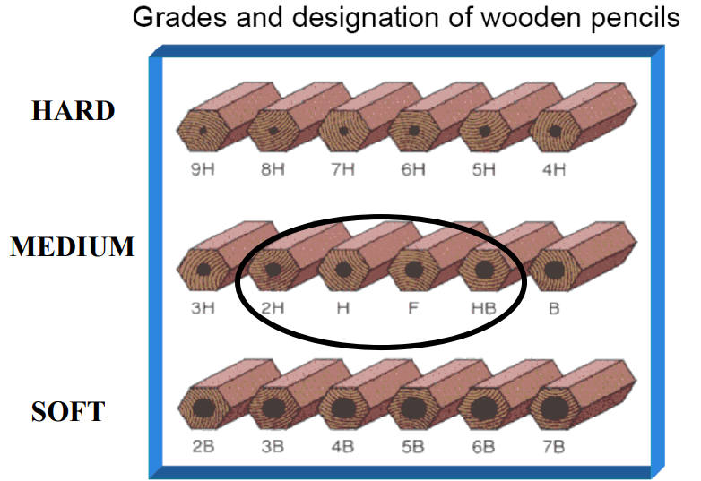
Pencils !!

Slide 16
Lines: Dark and Light
Outlines of Objects (where there is transition from material to no material), object inside lines (transverse intersection of two planes) should be darker (H, HB)
Construction lines, projection lines, hatching etc. should be lighter (2H)
However, darkness of line also depends on the pressure applied. Practice to control it.

Slide 17
Classroom Etiquettes
Attend all lectures, and labs without fail.
Be punctual.
Switch off your cell phones!
Official procedure for leave applies.
Make-up lab within the same week before the solutions are made public.

Slide 18
Course Objectives
Visualization in 3D space
Drafting : using hand held tools
Computer Aided Drafting! Perhaps not in online model.
Ability to read and make basic engineering drawings after doing this course.

Slide 19
Course Content
Constructional geometry.
Orthographic views.
Isometric Projection
Oblique & Perspective projection
Sections
Auxiliary Projection
Lines and Planes
Intersection of line / solid / plane
Intersection of solids and surface development.

Slide 20
Need for Engineering Graphics?
Convey design intent for manufacturing sector and other experts.
Completeness
Accuracy
Clarity
Communicate with customers.
Communicate with lawyers etc.

Slide 21
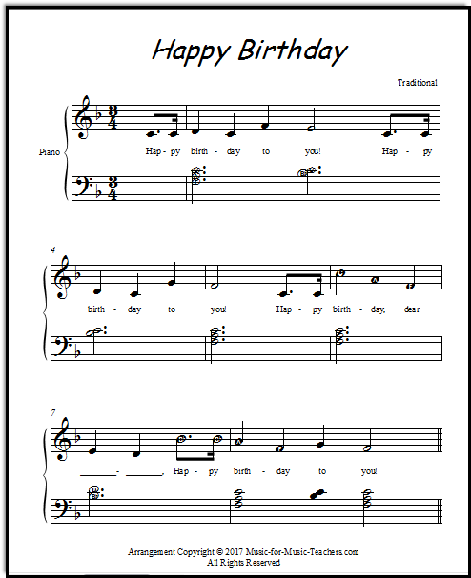
Musical Notes
These are the tunes of the song “Happy Birthday to you”.
You need to know the musical language to read this!

Slide 22
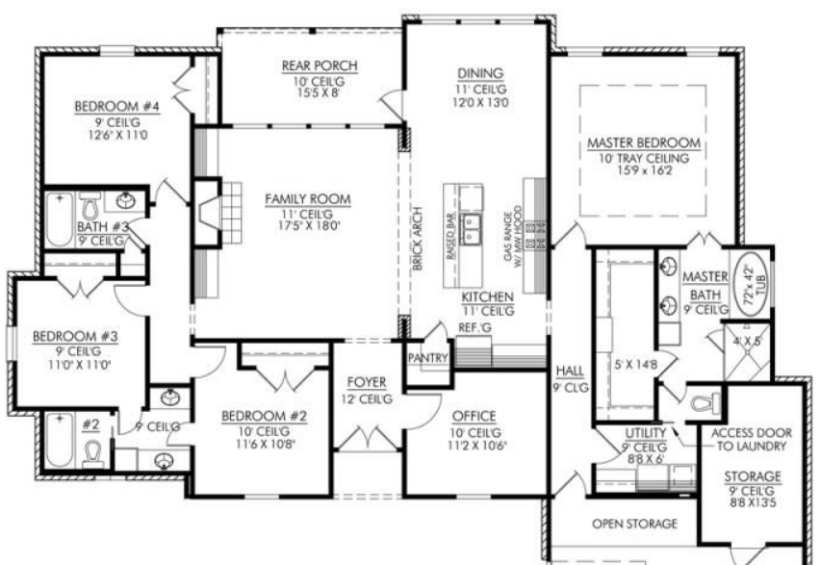
The Language of Architects & Civil Engineers
https://www.achahomes.com/four-bedroom-house-plans/

Slide 23
About Engineering Graphics
Letters
A,B,C….a, b, c….1, 2, 3…
Symbols Φ
Lines

Slide 24

About Engineering Graphics
Rules
Conventions
Standards
ISO
ASME
BS
Top view
Front view
Side view

Slide 25
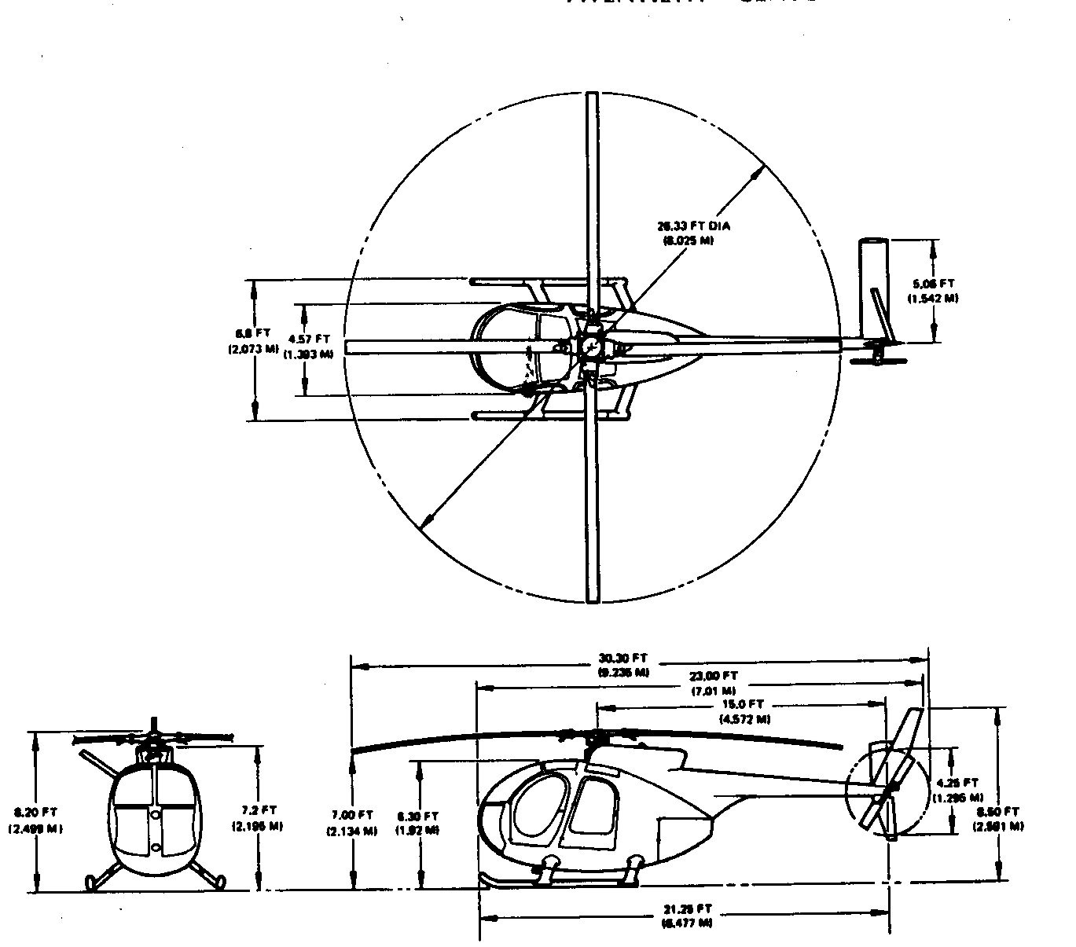
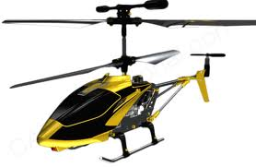
Engineering Graphics: Not Just for Engineers
Remote controlled toy helicopter

Slide 26
Drawings: As Old as Mankind!

Slide 28
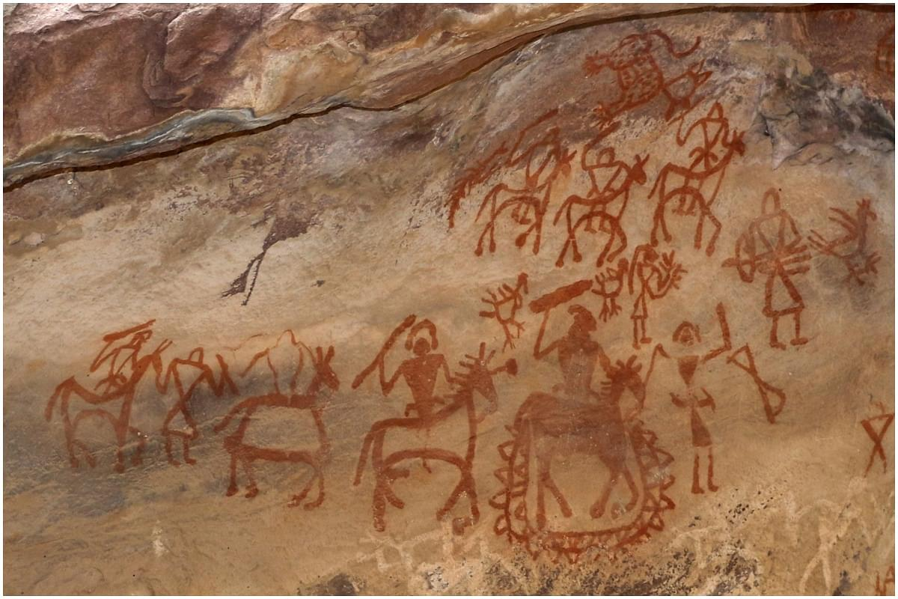

Slide 29
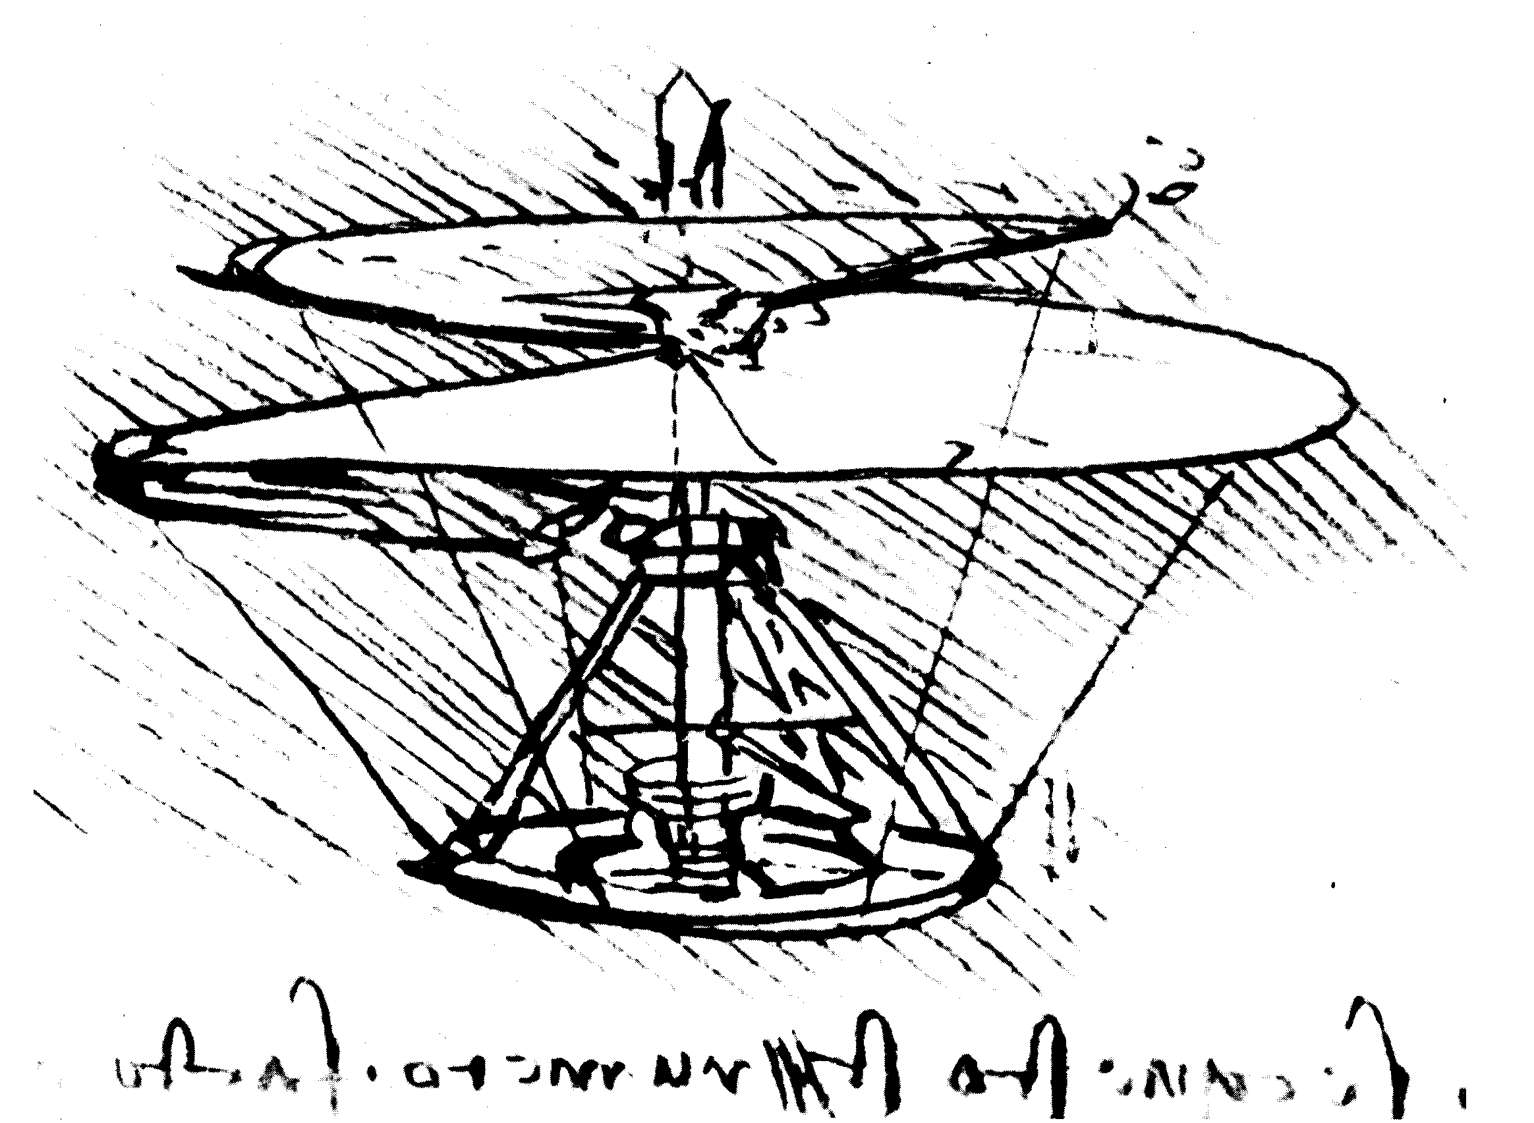
Helicopter

Slide 30
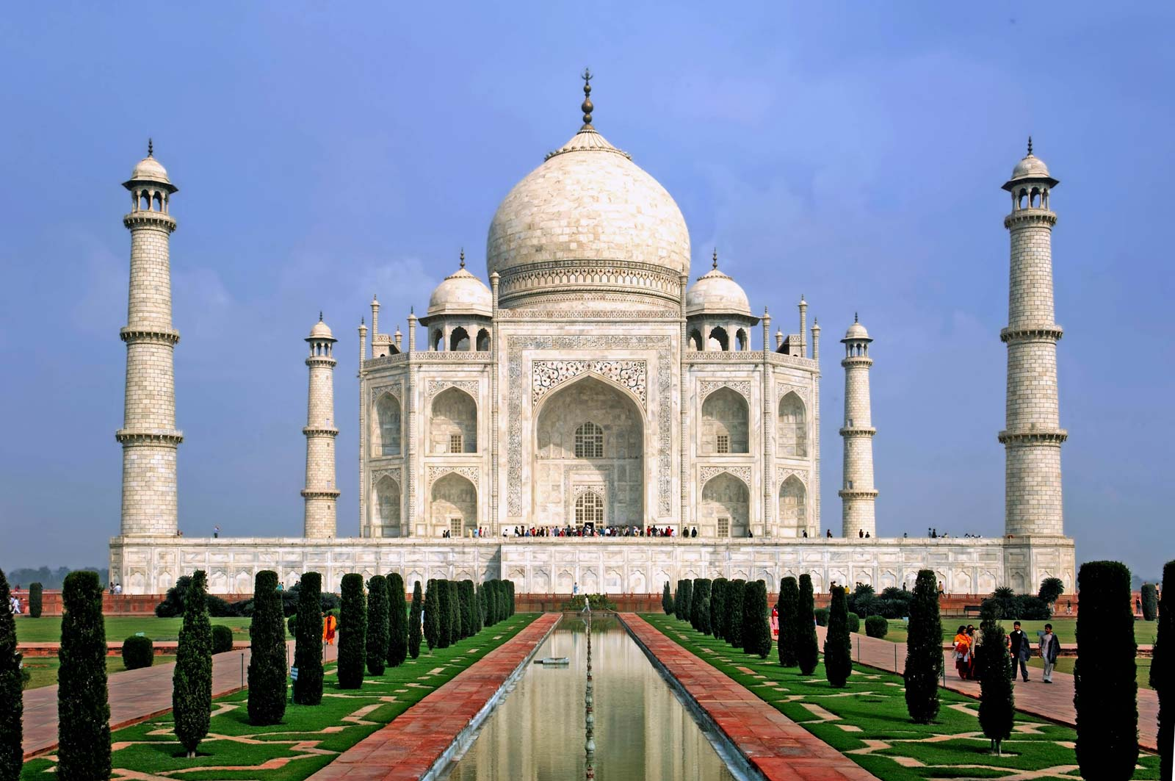

Slide 31
Engineering Drawing: Relevant to all !
Civil - buildings, streets, ..
Mechanical – machine parts, ..
Electrical – PCB design, circuit analysis
Computer science – Animation, simulations, virtual reality..
Aerospace – Aircraft design, space ship, ..

Slide 32
Acknowledgements
All past instructors and
drawing hall draughtsmen.

Slide 33
Thank You!

